Slide 1
Gender and Exercise
Presented by :
Presented to:

Slide 2
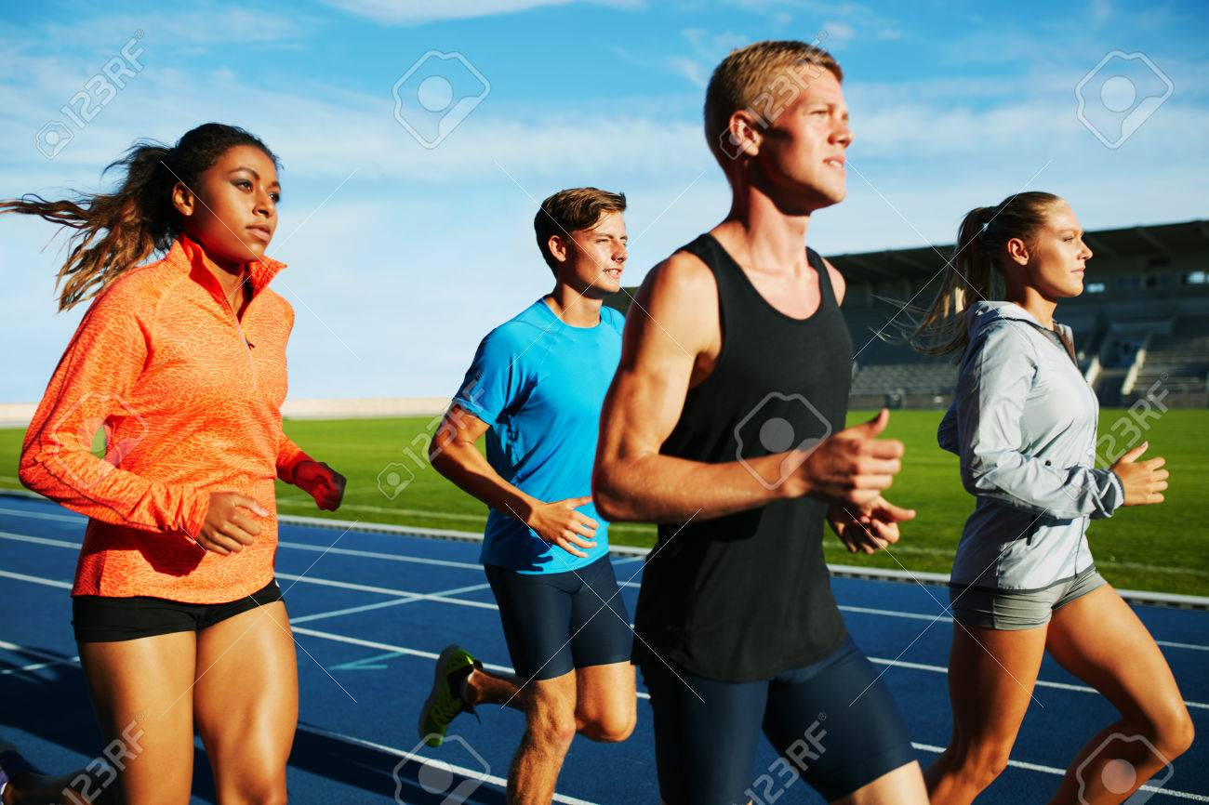
Physiological differences between Men and Women
Males reach their maximum training peak earlier than women
Males have higher speeds than females in physical exercises, for example in athletes
Females are more efficient in endurance than males in an exercise,
Notes:
As elaborated in the article “Physiological Differences Between Male and Female” Males athletes reach their maximum training peak earlier than women. In athletes, males have large capacities of carrying oxygen than women; on this hand, it makes them achieve their training peak before women. Males have higher speeds than females in physical exercises. Males have a more significant ratio of muscle to body weight, unlike women. Which gives room for higher speed and acceleration; this explains why female pace in different sporting activities is usually 1o% slower than men. Females are more efficient in endurance than males in an exercise, for example, in athletes. Endurance is often determined by one’s body efficient in converting calories to energy. In that regard, female athletes have more capacity of converting glycogen to glucose hence there more endurance.

Slide 3
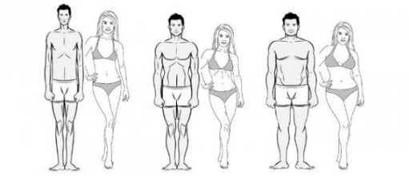
Different body types for males and females
There exists three body types for both males and females as illustrated. The ectomorph, the endomorph and the mesomorph.
Notes:
There exists three body types for both males and females as illustrated. The ectomorph, the endomorph and the mesomorph.
Ectomorph entails slim skinny individuals, endomorph comprises of individuals with solid and generally soft bodied while mesomorph are the large bodied individuals with large bone structures, muscles and have athletic physique.

Slide 4
Psychological differences between Men and Women
Women are able to verbally express their emotions more efficiently than men.
In order to think, men tend to initiate movement.
Men have the highest probability of taking risks than women.
In anticipating pain, women have the highest emotional response.
Men are more likely to engage in dangerous activities.
Women are more likely to peiceive neutral faces as being friendly.
Men are more likely to identify neutral faces as unfriendly.
The aggressive pathway of women emanates from verbal interaction while those of men stems from the brain.
Notes:
Maslow’s theory of motivation suggest that individuals tend to increase what they need or want to achieve in their lives. People tend to prioritize their needs based on their significance to their lives (Landy, J. & Farr, L., 2013). Employee’s job satisfaction is based on the needs of the employees including a number of factors that bring a considerable level of satisfaction. Maslow’s theory is based on biological, physical, psychological as well as social needs of human beings. The theory developed five-stage theory, which places individual needs in different classes and prioritizes their realization (Houldsworth, E. & Jirasinghe, D., 2016).

Slide 5
similarities between men and women psychology
Both, males and females have modes of caution in their exercise activities
They both have set goals
They too have attitudes for instance idealist, realist or even skeptical
They both have obstacles for instance self-deprecation and also impatient

Slide 6
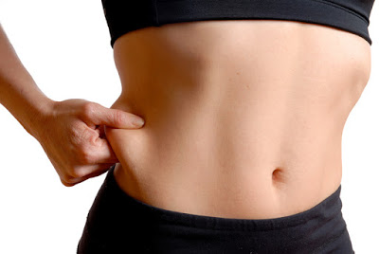
Normal Body Fat Percentages for Male and Females
Female
Have a higher body fat mass.
May be extremity fat.
Have lower lean mass compared to men.

Slide 7
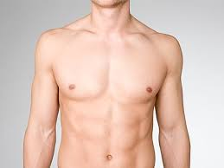
Continuation; Normal Body Fat Percentages for Male and Females
Male
Men have a higher visceral adipose tissue (VAT).
Men have a more damaging cardiometabolic risk profile compared to female when exercising.
Higher intramyocellular lipids (IMCL) and a higher risk profile.

Slide 8
How Exercise affects Males and Females’ Hormones
Estrogen helps maintains and develops both female characteristics and the reproductive system.
Exercise reduces the development estrogen dominance
Found in both men and women, testosterone is linked with sex drive, and has the crucial role of the production of sperms.
Testosterone also muscle and bone mass, the manner which men store fat in their body, and the production of red blood cell.
Exercise can raise the production of testosterone because it enhances muscle building.
Exercise enhances sexual urge for both men and women.
Individuals who don’t exercise are more likely to burn out during sex in compared to those who exercise.
Notes:
Also known as the Tow-factor theory, Herzberg’s theory was derived from studies aimed to determine factors that determine good or bad feelings of employees in regards to their jobs. Herzberg suggested that there are five main features of work, which result in satisfaction such as recognition, achievement, job itself, advancement and responsibility (Landy, J. & Farr, L., 2013). Employee motivation is often affected by several factors such as pay, supervision, approach, working conditions as well as interrelationship at work (Houldsworth, E. & Jirasinghe, D., 2016).

Slide 9
Lung Capacity between Men and women
The capacity of adult lungs amongst women is usually between 10 and12% smaller than men who have similar age and height.
The average vital volume capacity is approximately 4600 mL in males.
The average vital volume capacity is approximately 3400 mL mL in males
Breathlessness is twice as common in women as in males.
Lower total lung volumes are linked with increased breathlessness occurrence in both women and men.
Breathlessness prevalence among women is associated to their smaller absolute lung capacity.

Slide 10
Conclusion
Men are more likely to suffer from chronic diseases such as heart diseases, if they fail to exercise.
Diseases such as increased risk of heart attacks, strokes, and blood clots are experienced by women who do not exercise.
There are many benefits gained by men and women who exercise.
Men
Healthy blood vessels.
Lower cholesterol.
Weight loss.
Low risk of diabetes.
Lower risk of colon cancer
Women
Improves sleep.
Maintains healthier weight.
Prevents osteoporosis and bone loss.

Slide 11
Conclusion
Individuals are advised to consume the following healthy diet to improve their performance;
Low-fat or Fat-free versions of yogurt, milk and cheese products.
Less than 4 egg yolks each week.
Protein-based products such as lean meats, fish, skinless poultry, nuts eggs, beans and seeds.
The American Heart Association has recommended individuals to engage in about 75-150 minutes when engaging in aerobic activity.
The association also recommends a strength-training sessions for about 75 minutes.

Slide 12
References
Scraton, S., & Flintoff, A. (2002). Gender and sport: A reader. Psychology Press.
Simmons, M. P., & Foster, L. A. (2008). Sport and exercise psychology research advances. Nova Publishers.
Physiological Differences Between Male and Female Athletes. (2020). Retrieved 19 April 2020, from https://work.chron.com/physiological-differences-between-male-female-athletes-20627.htmlPhysiological Differences Between Male and Female Athletes. (2020). Retrieved 19 April 2020, from https://work.chron.com/physiological-differences-between-male-female-athletes-20627.html

